Slide 1




HIGH SECURITY REGISTRATION PLATES SCHEME
Update Process Flow
www.hsrp.in
Presented to : OEM Dealers

Slide 2



“
Update HSRP Process Flow
Dealer places an order for Embossed HSRP with FTA
HSRP order received at the respective Embossing Centre
HSRP Embossed and unique LIDs duly mapped against registration number in FTA HSRP portal
Embossed HSRP dispatched to respective Dealer
Embossed HSRP duly received at Dealer premises
HSRP physically affixed on customers’ vehicle by the dealer
www.hsrp.in
Contd.
1

Slide 3

“
Update HSRP Process Flow
Is the Dealer using the FTA HSRP portal for ordering Embossed HSRP?
No
Affixation date duly updated in OEM Portal as per OEM defined process.
Yes
Dealer to use FTA HSRP affixation date updation portal and update HSRP affixation date.
FTA to receive HSRP affixation date against the Registration number from the OEM server.
FTA Server
OEM Server
Auto scheduler to update the HSRP affixation date along with the Registration number in the VAHAN Server through Web Services
VAHAN Server
Contd.
1
www.hsrp.in

Slide 4
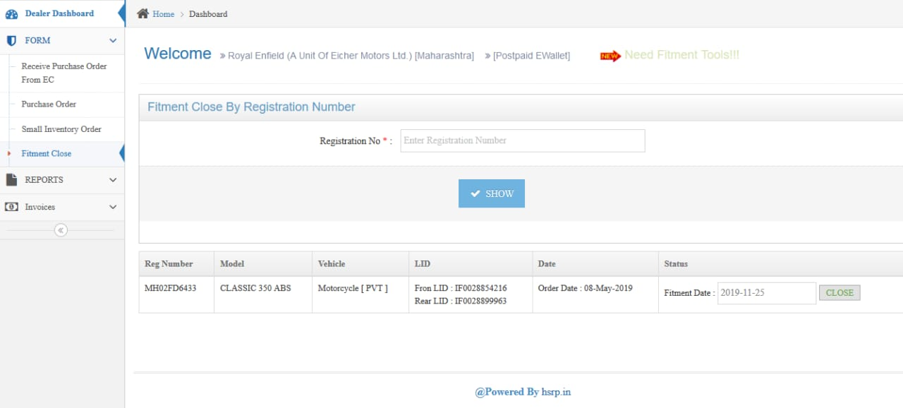
“
HSRP Affixation Through Web Portal (Dealer’s Login)
Enter Registration Number To Be Closed
Select Fitment Date & Click on CLOSE Button
www.hsrp.in
9

Slide 5
THANK YOU
FTA HSRP Solutions Pvt. Ltd.
Plot No B-225/226, GIDC Electronic Estate,
Sector – 25, Gandhinagar - 382024

